Slide 1
WELCOME!
Notes:
PRESENTER NOTES:
---This presentation:
is part of the “Seed Library Education Kit”, which includes a large format poster and take-away postcards
should be used alongside the poster and postcards as it offers complementary information about seed libraries and their role in seed security
is designed to take approximately 20 minutes
Is meant to be customized to reflect the context of your specific seed collection.

Slide 2

WHAT IS SEED SECURITY?
Seeds are the foundation of the food we eat: 9 out of 10 bites of food we eat originate with seed!
“Seed security” means that farmers have access to good quantities of high quality seed.
Seed security also includes biodiversity!
Notes:
TALKING POINTS:
--- WHAT IS SEED SECURITY?
Seeds are the foundation of the food we eat. Seed security means that farmers have access to good quantities of high quality seed. Seed security also includes biodiversity, growing many different types of seeds.
--- WHY DOES SEED SECURITY MATTER?
9 out of every 10 bites of food we eat originate with the planting of a seed. (SOURCE 2)
Virtually all vegetable seed planted in Canada is imported. If there was an interruption in this global seed supply, where would our food come from?
SOURCES:
UNFAO. http://www.fao.org/agriculture/crops/thematic-sitemap/theme/seeds-pgr/seed-sys/security/en/
Canadian Seed Trade Association. http://cdnseed.org/wp-content/uploads/2016/06/Trade-Winds-National.-Final-1.pdf

Slide 3
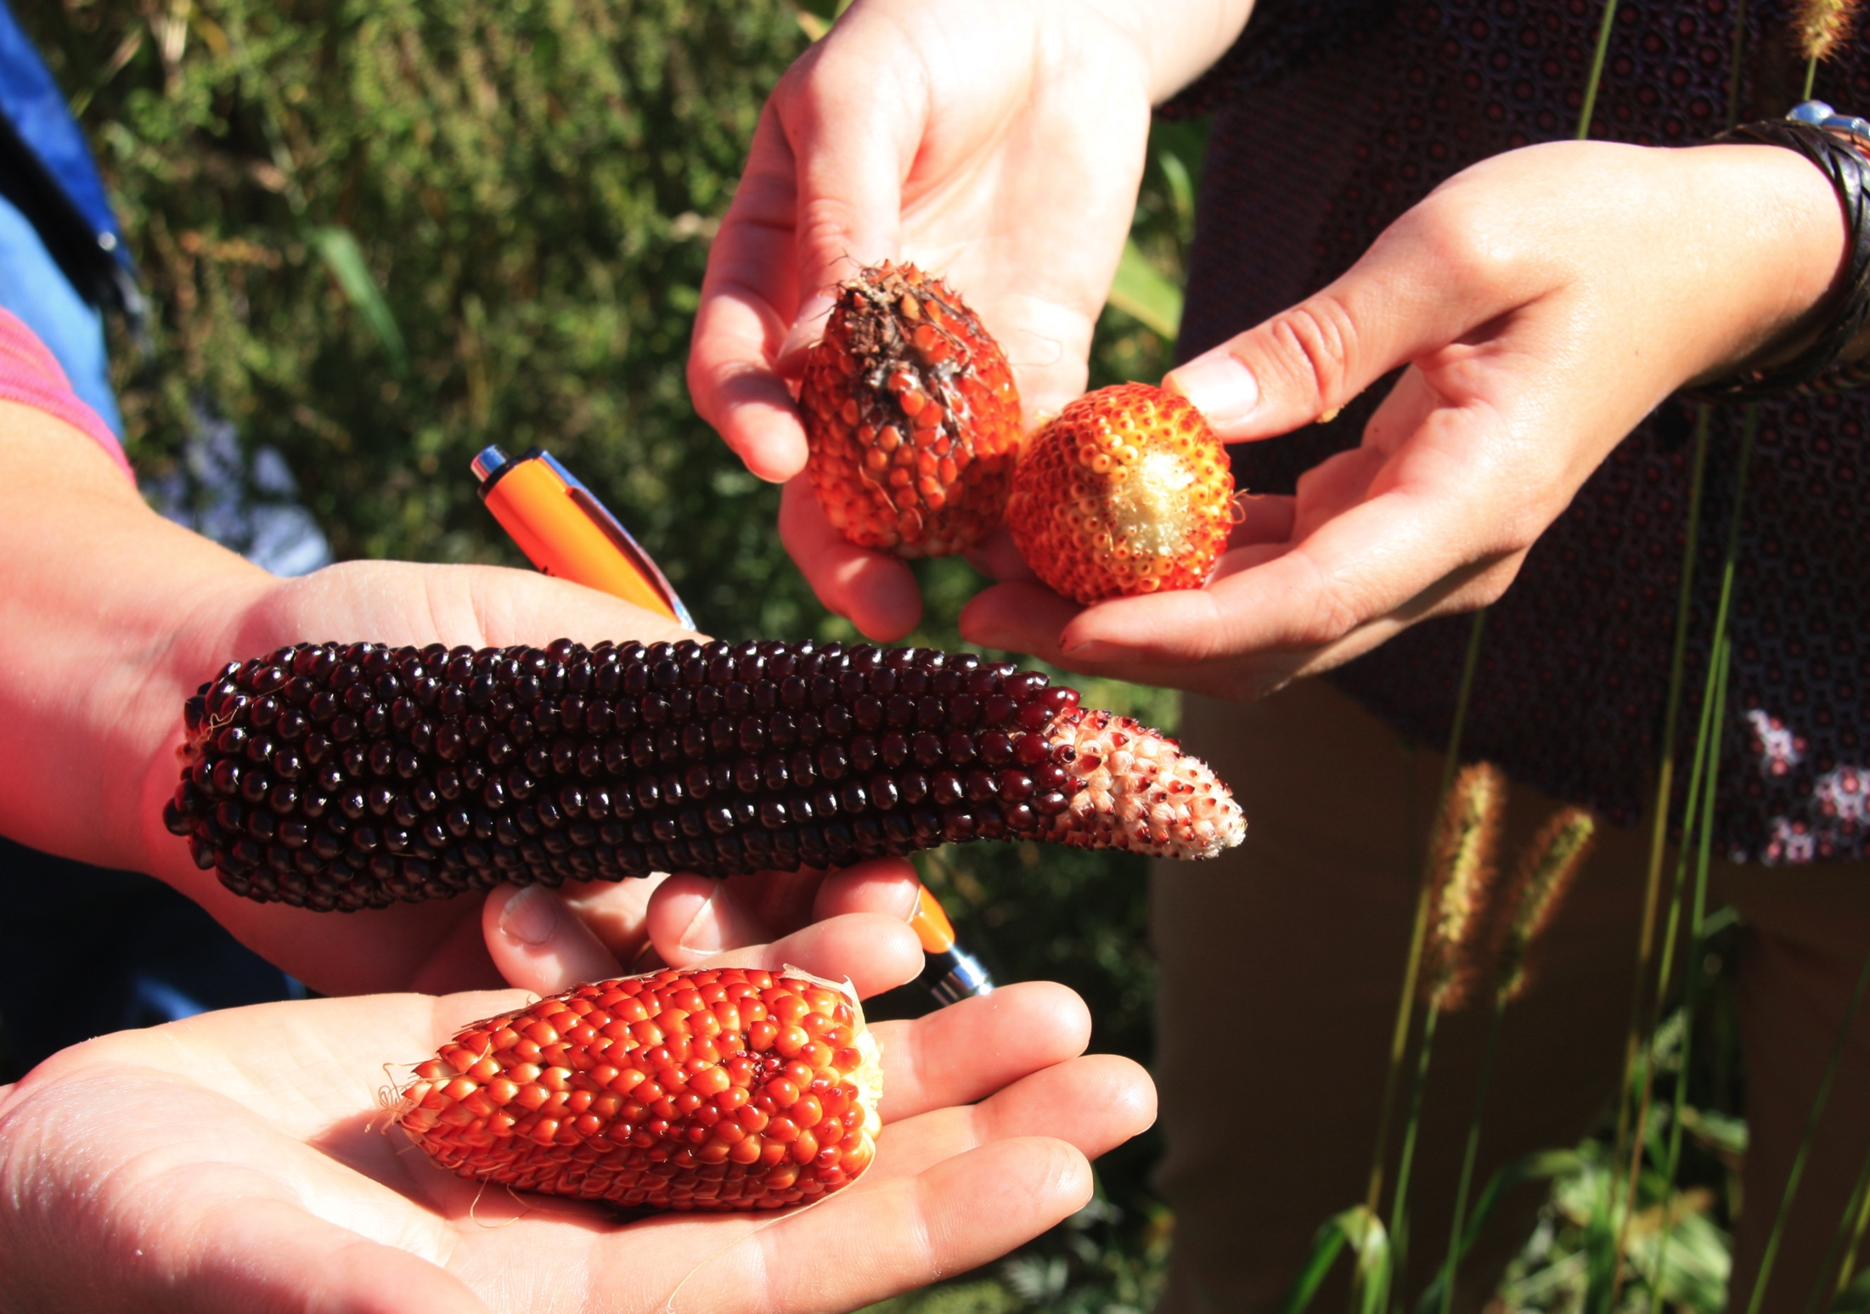
WHAT IS BIODIVERSITY?
Biodiversity = different crops + different varieties of crops.
Global biodiversity loss: 75% in the last century.
Farmers are stewards of agricultural biodiversity.
Notes:
TALKING POINTS:
--- WHAT IS BIODIVERSITY?
Agricultural biodiversity is an important part of seed security.
Biodiversity refers to:
the number of different crops being grown
the number of varieties of each of those crops. For example, growing potatoes, beets, and tomatoes represents a diversity of crops. Growing ‘Yukon Gold’ and ‘Russett’ potatoes; ‘Detroit Dark Red’ and ‘Touchstone Gold’ Beets; and ‘Brandywine’ and ‘Cherokee’ tomatoes represents even more diversity because there’s more than one type of each crop.
In the last century, we’ve lost 75% of the world’s agricultural biodiversity.
In North America, 90% of fruit and vegetable varieties are gone. (SOURCE 1)
Farmers are stewards of biodiversity! For generations, farmers have understood that the genetics of different plant varieties are valuable in different ways. Planting a variety of seeds helps ensure that at least some will produce food. (SOURCE 2)
SOURCES:
USC Canada. http://www.usc-canada.org/the-issues/seed-diversity
USC Canada. http://www.usc-canada.org/the-issues/seed-diversity

Slide 4
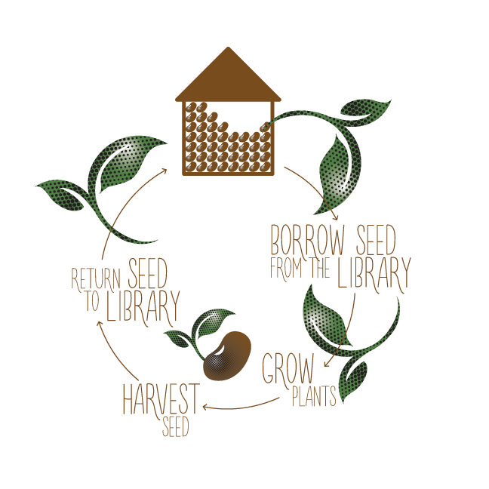
WHAT IS A SEED LIBRARY?
If you can grow food, you can save seed!
Being part of a seed library can help you learn.
Seed libraries may have volunteer opportunities!
Notes:
PRESENTER NOTES:
--- The graphic on this slide says “Return Seed to Library”. You could mention at this point whether or not you allow, or require returns of seed
--- If you are recruiting volunteers, you may want to elaborate on the last point.
TALKING POINTS:
---WHAT IS A SEED LIBRARY?
Farmers aren’t the only ones who can help biodiversity.
If you can grow food, you can also save seed!
Seed libraries encourage people learning how to grow food and save seed.
A seed library is a public collection of seeds where anyone can “borrow” a small quantity of seeds to grow. If the resulting seeds are saved, they may be returned to the library for the next grower!
Seed libraries aim to provide free public access to locally grown seeds
They promote awareness of seed issues
They’re not always found in book libraries! They can be mobile, or located in resource centres, community gardens, or anywhere.
They often function thanks to volunteers! (SOURCE 1)
SOURCES:
Glasgow, Kathleen. Mapping Nova Scotia’s Seed Collections Systems, page 5. http://www.acornorganic.org/media/resources/REPORT_Seed_Collections_Systems_FINAL_Sept_21_2016.pdf, page 5.

Slide 5
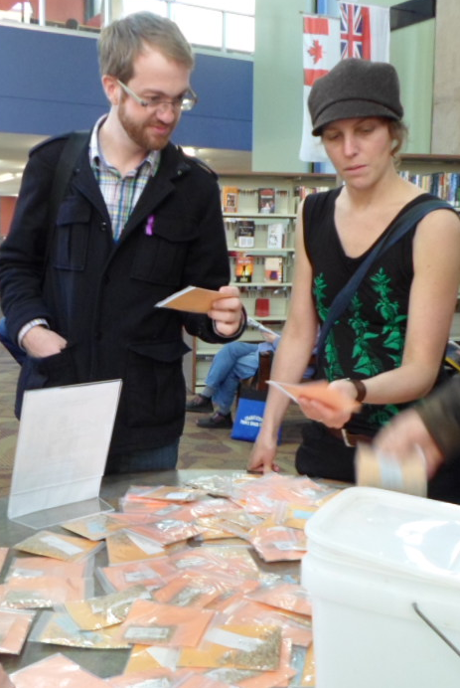
WHAT DO SEED
LIBRARIES DO?
Education
Advocacy
Steward rare seeds
Promote local seeds
Build networks
Create a marketplace
Notes:
PRESENTER NOTES:
--- When talking about “marketplace” (below), you may point out the postcards which list local seed companies.
TALKING POINTS:
--- WHAT DO SEED LIBRARIES DO?
EDUCATION: Raising awareness of seed issues and teaching seed saving skills
ADVOCACY: Protecting the rights of individuals to save and exchange seeds
STEWARD RARE SEEDS: Identifying and saving rare and unusual seeds
PROMOTE LOCAL SEEDS: Encouraging the development of locally adapted varieties
BUILD NETWORKS: Creating networks of gardeners, farmers and seed savers to share skills and resources
CREATE A MARKETPLACE: Helping to create a marketplace for local seed (SOURCE 1).
--- In Atlantic Canada, seed libraries focus on the education and networking aspects of seed (SOURCE 2).They are gathering places for people to learn more about gardening and seed saving, as well as seed issues. As the libraries evolve, networks develop among the membership which enables people to deepen their participation, help each other, and stay committed to seed in the long term. When seed library members want to broaden their seed choices, they may look to local seed companies for further options.
SOURCES:
(1) Dove, Charlotte. The Role of Community Seed Projects in Protecting Seed Diversity. https://seeddiversity.files.wordpress.com/2015/08/report-role-of-community-seed-banks.pdf. Page 13
(2) Glasgow, Kathleen. Mapping Nova Scotia’s Seed Collections Systems, page 5. http://www.acornorganic.org/media/resources/REPORT_Seed_Collections_Systems_FINAL_Sept_21_2016.pdf, page 5.

Slide 6
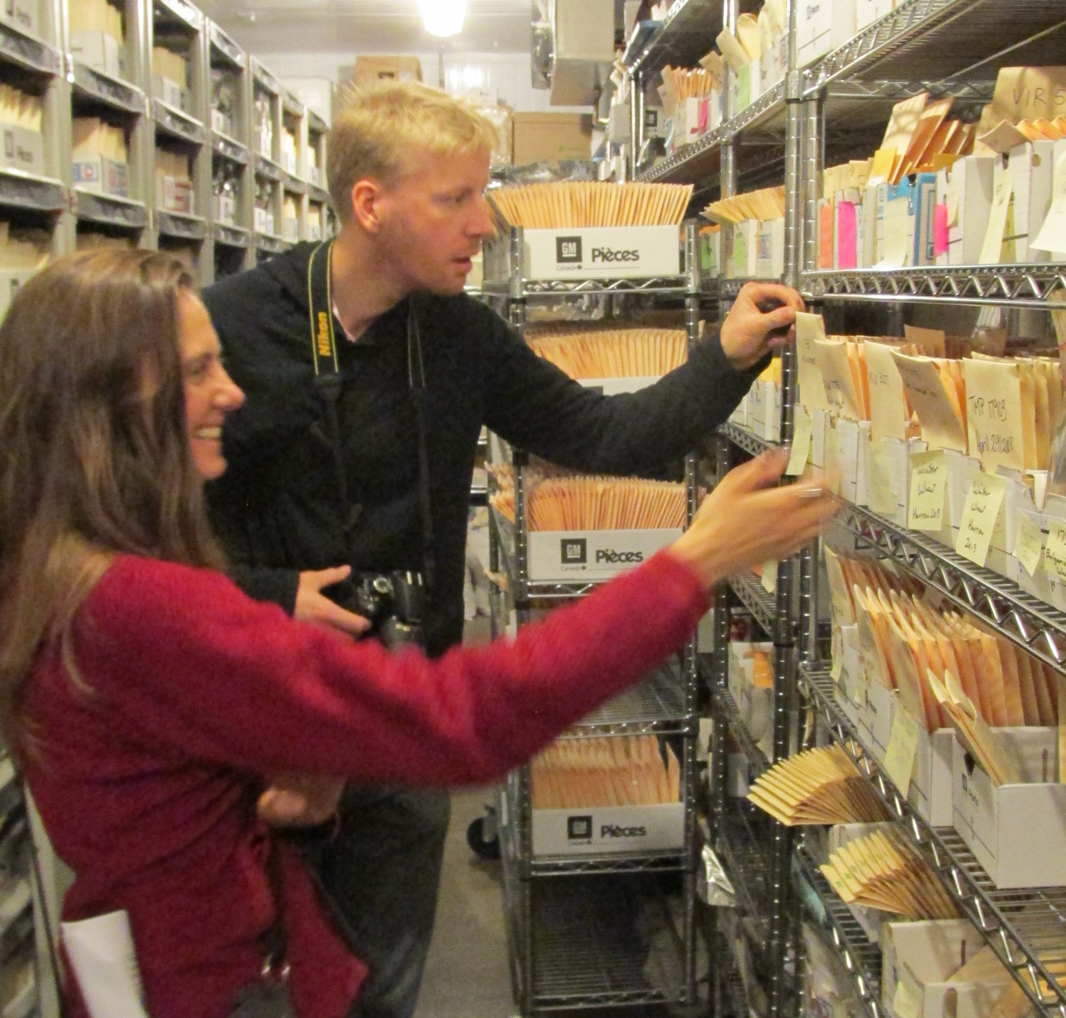
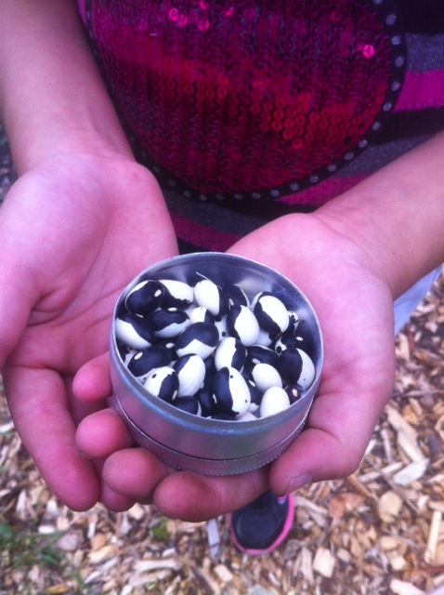
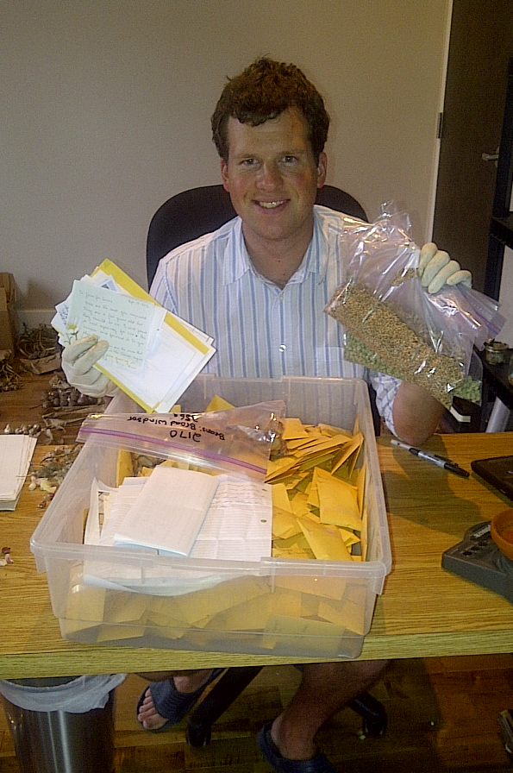

OTHER SEED COLLECTIONS…
Notes:
PRESENTER NOTES:
--- Use poster definitions for the different kinds of seed collections. (SOURCE 3)
--- Pictures (top left, clockwise): 2 people checking out the collection at PGRC Saskatoon. Small collection of orca beans headed to a seed bank. Paul, from Seeds of Diversity, entering seeds into their national seed bank. The Millenium Seed Vault in Svalbard, Norway.
TALKING POINTS:
--- OTHER SEED COLLECTIONS
The Canadian Federal Government operates 3 gene banks. 1 in Saskatoon, SK (for cereals), 1 in Harrow, ON (for fruit tree & small fruit crops), and 1 in Fredericton, NB (for potatoes.) (SOURCE 1)
Seeds of Diversity, a non-profit organization, runs a national seed bank in Waterloo, ON. (SOURCE 2)
There is a famous international gene bank, called the Millenium Seed Vault, located in Svalbard, Norway. This vault only accepts seeds from federal governments, and only the governments that contribute the seed can request it back. Its mission to guard the world’s seed supply against disaster has earned it the nickname “the Doomsday Seed Vault.”
SOURCES:
(1) Plant Genetic Resources Canada. http://pgrc3.agr.gc.ca/about-propos_e.html
(2) Seeds of Diversity. http://seeds.ca
(3) ACORN. http://www.acornorganic.org/resources/seedsecurity

Slide 7
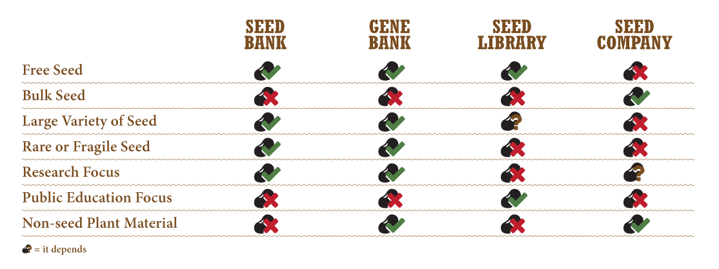
OTHER SEED COLLECTIONS…
Notes:
TALKING POINTS:
These are generalizations to give you a sense of each kind of collection and which ones are useful for what.
There are many things that seed libraries don’t do. But a seed library’s focus on public education is really important because no one else does that. Occasionally, a gene bank or seed company does education, but it’s usually focused on a specific audience (farmers, researchers, or clients) and it’s usually secondary to another aim (for example, selling seeds.)
The focus of a seed library is like the focus of a book library—to get people engaged and learning! At a seed library, the focus is on developing a better understanding of what seeds are, how to use them, and how they’re connected to the foods we eat everyday!
The people joining a seed library for the first time today could be the ones who, tomorrow, rescue a rare vegetable variety, start a seed company, or educate the next generation of seed savers.

Slide 8
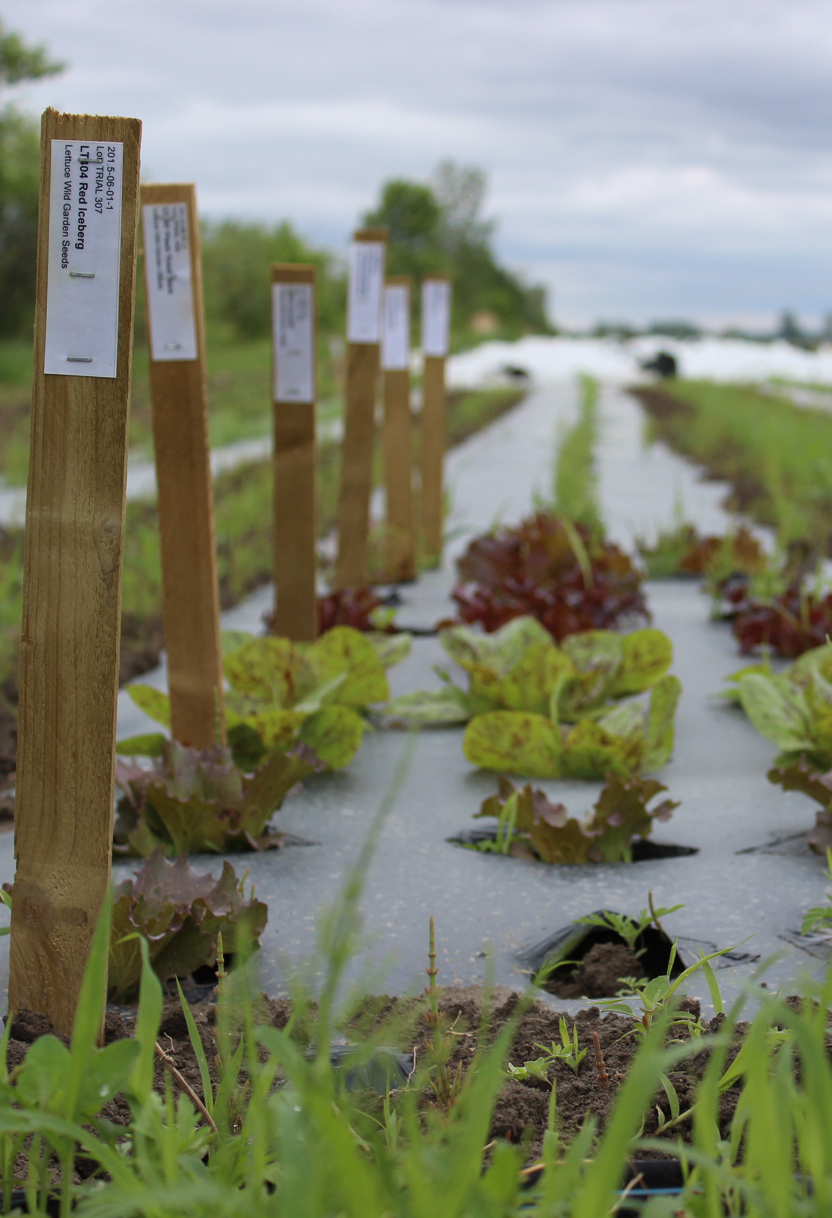
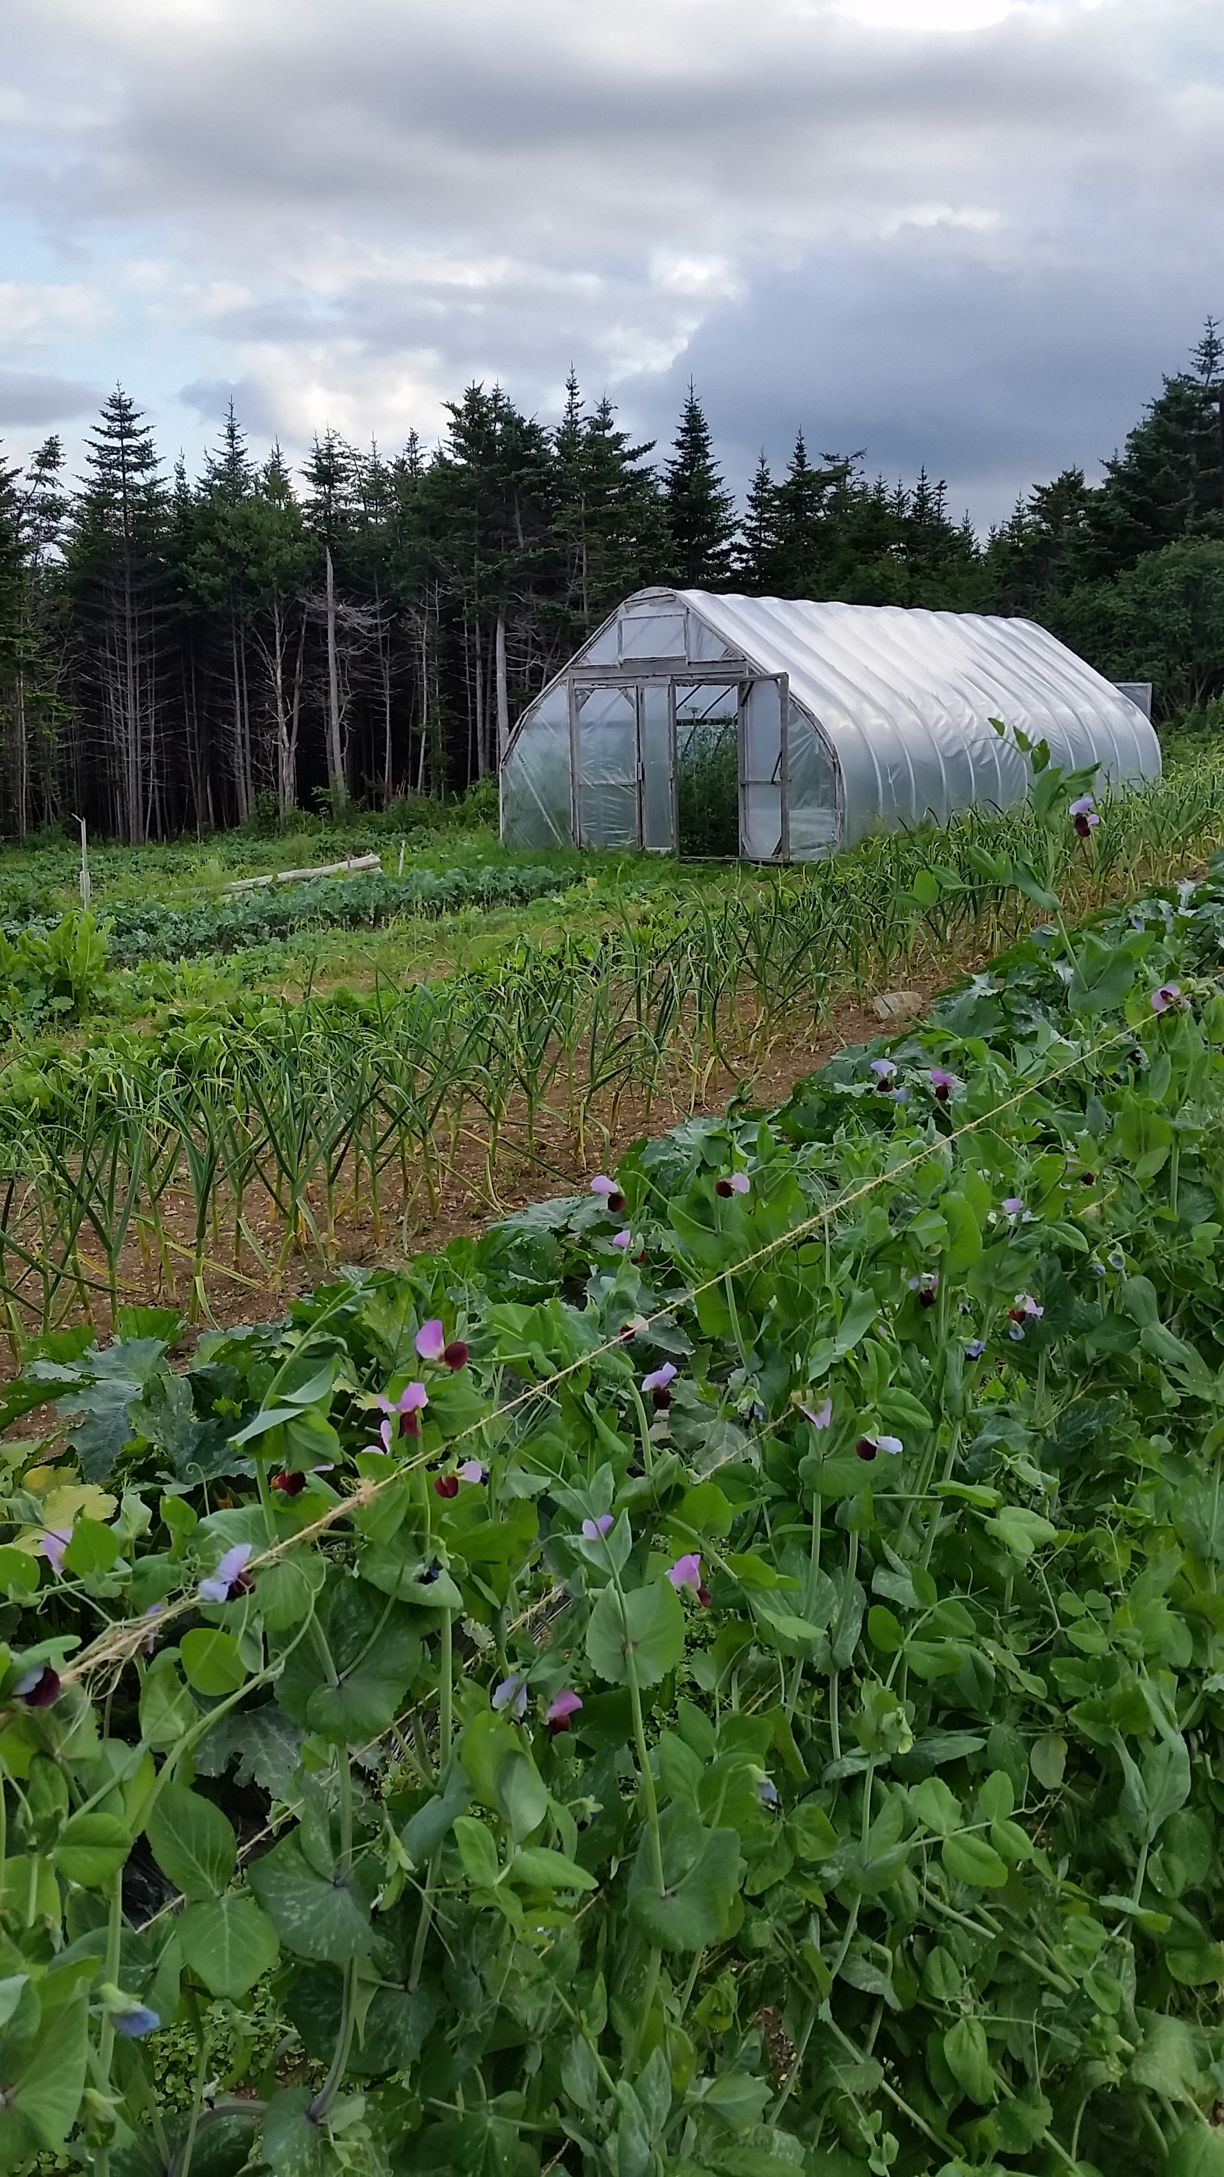
LIVING SEED BANKS
Notes:
TALKING POINTS:
There’s one more very important place that we conserve seeds - on our farms and in our gardens!
When seeds are planted outside, they’re always learning, adapting, and improving their genetics. Seed saving gardens may be called “living seed banks”.
When plants are growing outside, they’re also exposed to a lot of risk!
A good reason to keep seeds in a seed bank or with a seed company is so that - if farmers experience crop failure - they have a place to go to get more seed.
Both kinds of seed conservation – inside and outside – are important to a healthy seed system.

Slide 9
EXPECTATIONS
Everyone is welcome!
Become a member today to start borrowing seeds!
Beginners: we have books and resources to help.
Advanced seed savers: are you interested in sharing your knowledge?
Notes:
PRESENTER NOTES:
--- Here the poster is setting members’ expectations about what it means to be part of a seed library.
--- Please customize this information so it’s relevant to your seed library. For example:
are there membership requirements you should clarify?
are there limits to how much/what kind of seed members can borrow?
do you have a collection of books and resources to share? Please point out that there are great resource websites on the postcard.
do you have workshops or other group activities planned?
TALKING POINTS:
Everyone is welcome at the seed library!
Beginner and advanced seed savers may have different roles here. For example, our workshops both support beginners and utilize experts.
Thank you for coming to be part of this community! We’re looking forward to working with you!

Slide 10
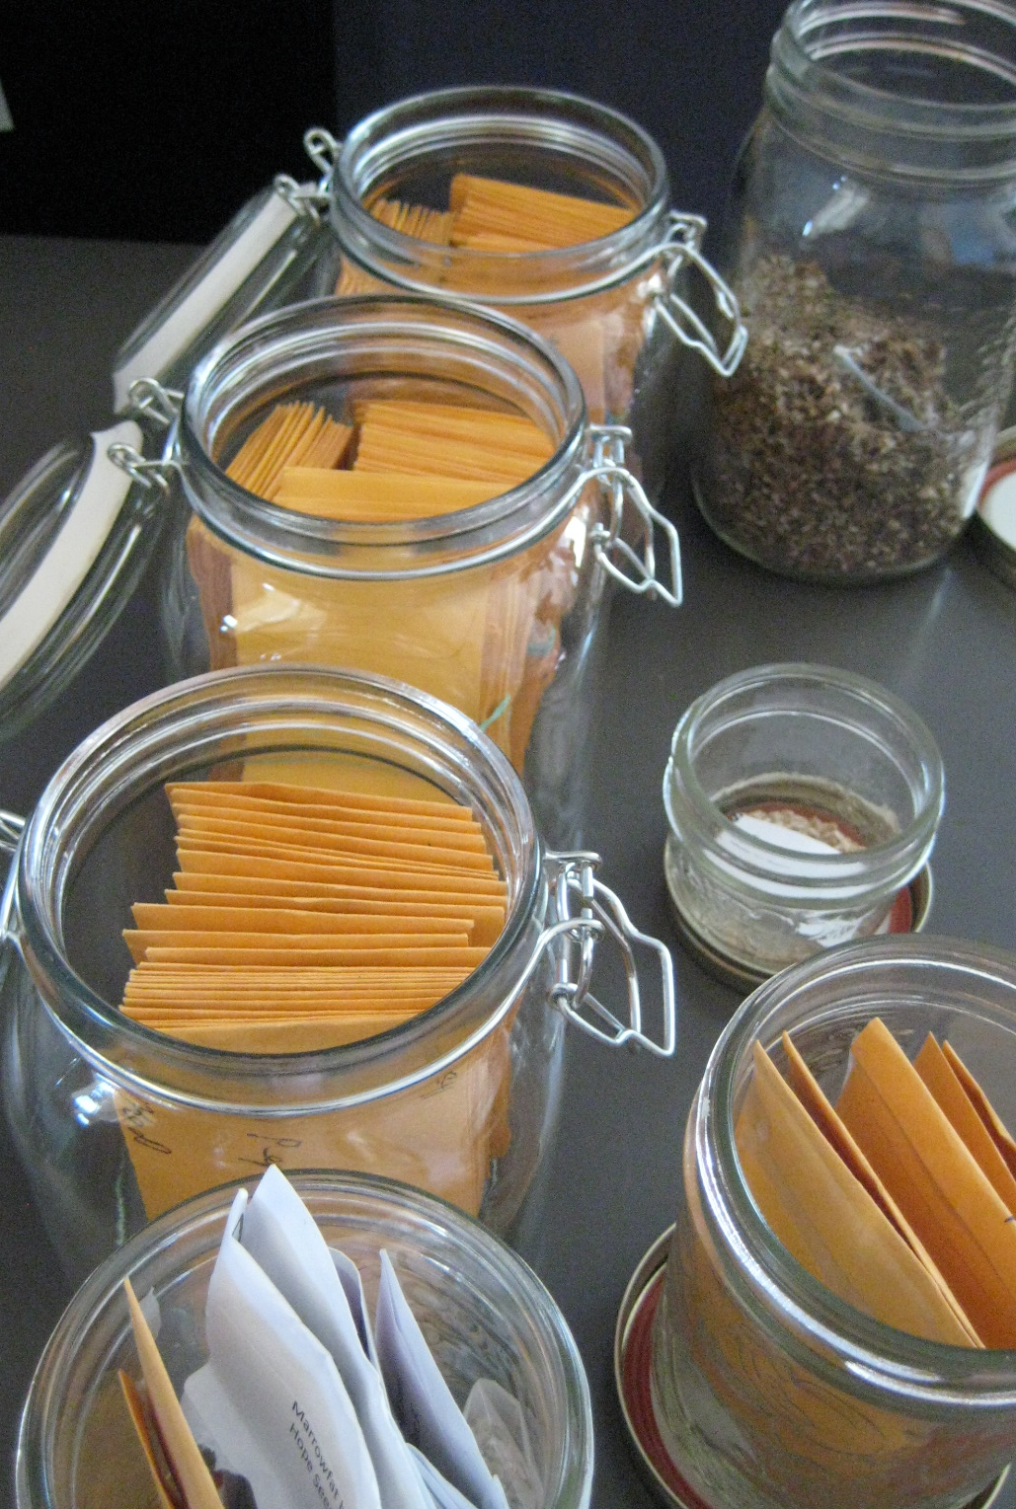
SEED INTEGRITY
High quality seed:
  germinates well
  has not been cross- pollinated
  is well labeled and stored
Our seed sources
Our storage practices
How you can help
Notes:
PRESENTER NOTES:
--- This poster section gives only basic information about seed quality. Please customize this slide with info particular to your seed library. For example:
Where do you source your seed?
How do you store your seed? (Is the seed clean, dry, and in a dark place?)
Do you ask members to evaluate their skill before giving them seed?
Will you accept seed from members after harvest? If so, will you ask them to germ test it?
TALKING POINTS:
--- SEED INTEGRITY
Since the beginning, seed libraries have been concerned about the issue of seed quality.
Low quality may refer to poor germination (seeds that don’t sprout), or seeds that have been “cross pollinated” and, as a result, don’t grow into the expected variety.
Improper storage or handling, or poor seed labeling compounds these problems.
Achieving high quality seed is a long term goal. It’s natural for beginner seed savers to make mistakes – that’s how you learn!
There are a few ways that seed library members can increase their chances of success: 1) choose crops that are appropriate for your level of skill and your growing space 2) take advantage of the many online and hard copy resources available to learn about the basic principles of seed saving 3) join a seed saving workshop to talk with an expert!
If you’re a farmer, or someone looking for very high quality, dependable seed, you might want to consider buying seed from a local company, rather than sourcing it here. We are all learners and volunteers and everyone is doing their best!

Slide 11
QUESTIONS?
Notes:
PRESENTER NOTES:
--- You can copy and paste this slide into the presentation whenever you think it’s appropriate to pause and take questions from the group.

Slide 12
REFERENCES
  UN Food and Agriculture Organization
  Canadian Seed Trade Association
  USC Canada
  Mapping Nova Scotia’s Seed Collections Systems
  The Role of Community Seed Projects in Protecting Seed Diversity
  Plant Genetic Resources Canada
  Seeds of Diversity
  Atlantic Canadian Organic Regional Network (ACORN)
Notes:
FULL REFERENCES
UNFAO. http://www.fao.org/agriculture/crops/thematic-sitemap/theme/seeds-pgr/seed-sys/security/en/
Canadian Seed Trade Association. http://cdnseed.org/wp-content/uploads/2016/06/Trade-Winds-National.-Final-1.pdf
USC Canada. http://www.usc-canada.org/the-issues/seed-diversity
Glasgow, Kathleen. Mapping Nova Scotia’s Seed Collections Systems, page 5. http://www.acornorganic.org/media/resources/REPORT_Seed_Collections_Systems_FINAL_Sept_21_2016.pdf.
Dove, Charlotte. The Role of Community Seed Projects in Protecting Seed Diversity. https://seeddiversity.files.wordpress.com/2015/08/report-role-of-community-seed-banks.pdf.
Plant Genetic Resources Canada. http://pgrc3.agr.gc.ca/about-propos_e.html.
Seeds of Diversity. http://seeds.ca
ACORN. http://www.acornorganic.org/resources/seedsecurity

Slide 13
THANK YOU!
Notes:
PRESENTER NOTES:
--- Don’t forget to pass out the postcards, drawing everyone’s attention to the reverse side where they’ll find websites to search out more information
---Please give credit to ACORN and THE BAUTA FAMILY INITIATIVE for generating and sharing this content.

