Slide 1
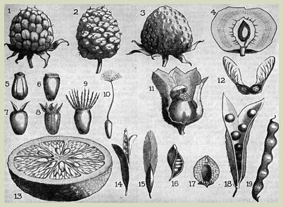
seed Saving
To see things in the seed, that is genius.
Lao Tzu
Notes:
Have this slide on the screen as the participants come into the workshop
PLEASE NOTE: ALL PHOTOS AND IMAGES IN THIS POWER POINT ARE OWNED BY ORGANIC SEED ALLIANCE AND ONLY TO BE USED FOR TEACHING THIS SEED SAVING CLASS WITH THIS POWER POINT PRESENTATION. TO CONTACT OSA FOR MORE INFORAMATION PLEASE VISIT:
WWW.SEEDALLIANCE.ORG

Slide 2
introductions
(one minute per person)
Name
Occupation
Foodshed: your ecological/agricultural region
Your history of saving seed
What is your goal for this training.
Notes:
Introduce yourself.
Ask participants to introduce themselves in one minute. Pass a one minute egg timer and monitor the length of their own introduction.

Slide 3
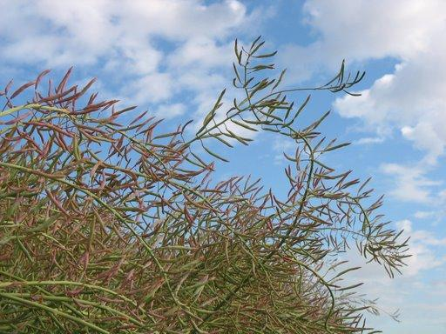
Our goal: To increase the conservation
and spread of ecologically grown,
bio-diverse and regionally adapted seed
Notes:
Introduce the Bauta initiative and it’s mission to support seed saving in Canada.

Slide 4
Fundamental ideas:
Sustainable food systems rely on sustainable seed systems.
Seed is a natural resource that should be available to all.
Seed saving is a skill that should be learned and shared.
Continued practice of seed saving by individuals can contribute to community, regional, national, and international seed security.
Notes:
Discuss these ideas and add any personal anecdotes
Invite group to add personal perspective
Explain the trainer of trainer model of teaching and how the last two concepts are being address by this training.

Slide 5
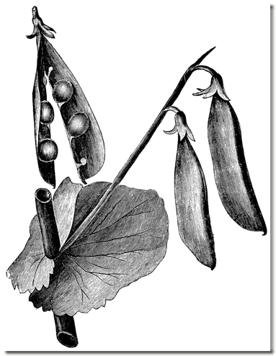
4 questions to ask before you begin growing seed
Why am I saving seed?
What seed is best for me?
What biological principles are fundamental to seed saving?
What skills and techniques are needed to save seed?
Notes:
Tell participants that at the end of the class we will return to these questions.

Slide 6
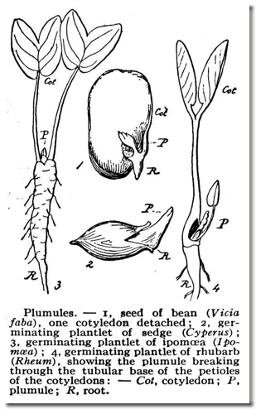
6 learning modules will help answer these questions:
Why save seed.
What seed is best for me.
Biological principles: Plant taxonomy.
Underlying biological concepts.
Skills and techniques for saving seed.
Review: final reflections on the 4 seed saving questions.
Notes:
Share agenda
Explain the three part approach to each module:
Introduction of the concepts
Activity to practice and reinforce the concept or skill.
Journal reflection (this one will be offered if time is available within the agenda)

Slide 7
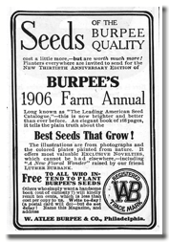
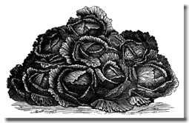
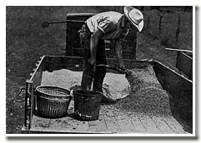
1. Why save seed?
Notes:
Module #1

Slide 8
A. Why save seed?
As a member of a community, nation and planet.
Why is saving seed important for maintaining a sustainable food system?
Notes:
Brainstorm a list with participants and then discuss responses.

Slide 9
b. Why save seed?
As an individual.
On what level am I interested in saving seed?
To just play around in my garden, maybe seed swap.
To adapt a variety to your climatic conditions and insure a source of resilient seed.
To preserve the genetics of a variety (an heirloom perhaps) and insure a reliable source.
To contract with seed companies to produce seed as a source of income.
Other?
Notes:
Invite participants to contribute answers. How participants answer this question may influence the emphasis of discussions throughout the training. If there is time, ask participants to share Journal reflections.
Journal activity: Construct two scenarios: If current trends in the seed industry continue, describe seed sources and seed quality in five years. What might be different if you save seed and/or train others to save seed.

Slide 10
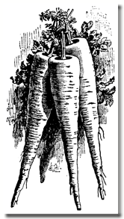
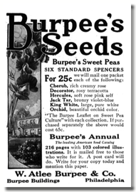
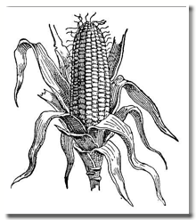
2. What seed is best for me
Notes:
Module #2 – Introduce topic. Selection of the seed you choose to save has implications for your success and reflects choice in genetic conservation.

Slide 11
Seed Choices:
Open Pollinated (OP) – OP’s produce seed that closely resemble the parent. OP varieties are a result of combining parents that are genetically similar. If you plant an OP, save seed and grow that seed the next season, the plants will look like the ones you grew last year.
Heirloom – Non-hybrid/open-pollinated varieties that have been passed down from generation to generation (>50 years old is generally considered an heirloom).
Hybrid (F1) – F1’s are a result of a controlled crossing of inbred, genetically distinct parent populations. Seed saved from F1’s will appear very different from their parents, only a few plants will look like the original F1 variety.
GMO Varieties - Varieties in which genes have been inserted into the DNA of the host variety. The genes that are transferred are often from different species, genera, or even kingdoms (e.g. Bt toxin).
Notes:
Open Pollinated and Heirloom Varieties
self perpetrating and can provide a reliable source of seed.
Often have inherent genetic diversity & potential for selection for improved local adaptability, even if the plants appear similar visually.
Hybrid
Will not grow “true to type” therefore not a reliable source.
May be good source of genetic material for a plant breeding project.
Discussion topics (as appropriate for the audience)
Hybrid uniformity and vigor…why hybrids are used in farming and gardening.
Explain that you can create an OP from a hybrid if you are interested in a long range breeding project.
The amount of time spent with GMO’s depends upon you and your audience. Consider referencing
David Suzuki, Canadian geneticist won the Right Livelihood Award in 2009. www.davidsuzuki.org/david/.../David_Suzuki_Biotech_essay.... - Canada
http://www.cbc.ca/archives/categories/economy-business/agriculture/genetically-modified-food-a-growing-debate/david-suzuki-speaks-out-against-genetically-modified-food.html

Slide 12
Seed Choices
From Annuals – Plants that require only one growing season to produce seed and complete their life cycle.
From Biennials – Plants that require two growing seasons to produce seed and complete their life cycle.
From Perennials – Plants that live more than two years, usually producing flowers and seeds from the same root year after year.
Notes:
Annuals - Lettuce, Sunflower, Garden Pea Cucumber, Broccoli, Common Bean, Corn. Tender perennials – Tomato, Pepper.
Much variation in time of flowering.
Must plant early enough to mature seed.
Biennials - Carrot, Beet, Cabbage Clan, Celery, Onions, Parsnip, Swiss Chard, Turnip.
Vernalization: approx. 8 – 10 wks @ < 50°F (10°C)
Must consider both vegetative and storage stages of life cycle.
Plant for optimum over-wintering size and condition. Expect to loose some of crop over winter.
Perennial - Rhubarb, Alfalfa, Forage Grasses, Asparagus, many ornamental flowers and culinary herbs.
Must be winter hardy for your area.
Often don’t produce large quantities of seed each year.
Journal Which would you choose and why.

Slide 13
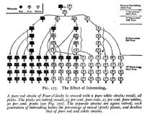

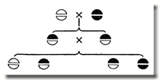
3. Underlying biological principles: Plant Taxonomy
Notes:
Module #4
.

Slide 14
KINGDOM
PHYLUM
CLASS
ORDER
FAMILY
PLANTS ARE GROUPED BASED ON SIMILAR STRUCTURES
GENUS
A TIGHTER GROUP THAT COMMONLY HAS SIMILAR FLOWERS AND SEED STURCTURES
SPECIES
A GROUP THAT CAN BREED TOGETHER
Taxonomy is a system of arranging plants into related groups based on common characteristics.
Notes:
For seed saving the most important concept is knowing that plants that share the same species name can cross. The species name is the binomial (genus and specific ephithet).
Knowledge of genera and families is also useful to learn because species in the same genus or family often have similarities in their reproductive structures and thus similarities in seed saving practices.
For example:
Brassica oleracea has many members: cabbage, kale, broccoli, Brussels sprouts and cauliflower. All of these crops were selected by humans from a wild kale type plant. As a seed grower, it can be a challenge if you want to grow more than one of these in the same area. Knowing the genus and species provides you with the insight and foresight to use isolation techniques to avoid any unwanted cross pollination. We will cover more on this topic later in the class.
Also, the binomial name gives you insight into any wild or native plants that have potential for crossing with your crop. For example: Daucus carota is the species of both carrots and Queen Anne’s Lace(a wild relative of the carrot).

Slide 15
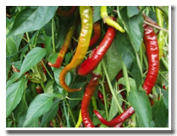
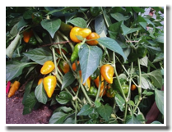
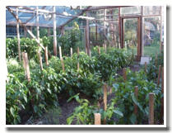
The flowers of peppers primarily self pollinating, but insect cross pollination is common.
BOTH the cayenne pepper variety and the jalapeno pepper variety pictured to the right belong to:
Genus: Capsicum
Species: Capsicum annuum
What advice would you give this seed saver for maintaining the genetic purity of each variety if they want to grow both in the same greenhouse?
What’s in a name?
cayenne
jalapeno
Notes:
The next module will cover floral anatomy and reproduction. But at this point the participants should understand that the two varieties can cross pollinate.
Answer to the question:
Advise grower to only grow one species each year, or
Create a barrier for insects to avoid cross pollination, such as a bag or tent around certain plants for seed
From Seed to Seed, page 152
“A research study in New Mexico State University showed up to 80% crossing in some populations of peppers.

Slide 16
Knowing the family of your plants will help you generalize the seed saving techniques from one member of the family to other members of that same family. For example:
Family – CUCURBITACEAE
This family contains squash, melons, cucumbers and gourds. Members of the same species will accept pollen from other crops and varieties within the species. Isolation to control crossing within the species is critical with diverse crops such as squash.
Family – CUCURBITACEAE
Genus – Cucurbita
Species – Cucurbita pepo
Variety – Black Beauty zucchini
Variety – Yellow Crookneck squash
Variety – Connecticut Field pumpkin
Variety – Patty Pan scallop
Variety – Spaghetti squash
Notes:
Members of this family share common mating systems, isolation distances, population sizes, harvesting and cleaning methods for seeds. Learn the techniques for one and you can generally apply that pattern to other members of the same family.
DISCUSS why hand pollination of squash plants is a common practice for growers wanting purity of seed stock.
REVIEW the following photos of the major families to point out patterns and similarities within the family. Also look for members of the same species that can cross.

Slide 17
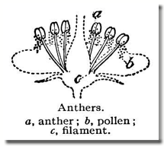
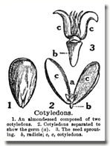
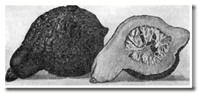
4. Underlying biological Concepts: reproduction
Notes:
Module #3

Slide 18
4. Underlining Biological Concepts - Reproduction basics:
Flower anatomy: structure and function.
The “Mating System” of your plant…how it pollinates.
Techniques that improve or maintain seed physical and genetic qualities.
Notes:
Share the glossary of terms with participants.

Slide 19
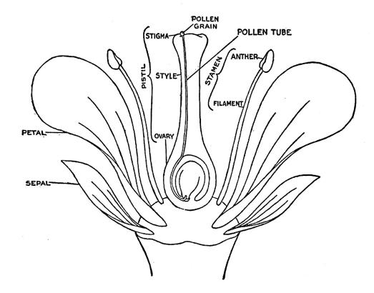
A. Flower anatomy
A flower is the reproductive organs of a plant wrapped in sepals and petals.
Notes:
If you are planning to include the flower dissecting activity in your class, now is a good time for that exercise. Otherwise review floral parts with participants with the diagram. Point out the male and female floral parts. Explain that this is a model of a perfect flower. Show how the pollen tube grows to deliver pollen to the ovary. The pollen will not germinate or the pollen tube may not grow if the temperature and humidity is not appropriate for the crop being grown.
Flower Dissecting Activity:
Provide each participant with a fresh “perfect” flower, razor blade and a hand lends.
Use the diagram to review the basic male and female parts of a flower AND explain their function.
Dissect the flower with participants and identify the mate and female structures.
If possible have several flower samples available to compare and contrast.

Slide 20
Flower function:
Pollination: Pollen produced from the stamen must land on the surface of the stigma.
Fertilization: Once it has landed on the stigma, pollen must germinate and grow a pollen tube down through the style to the ovary and fertilize the ovule. Each fertilized ovule becomes a seed.
Notes:
Cover concepts of pollination and fertilization.

Slide 21
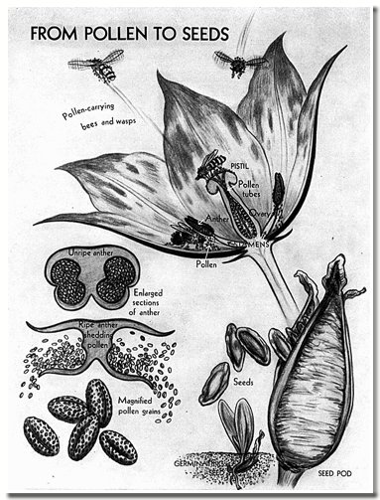
Notes:
Point out that a seed will not be formed without the success of both pollination and fertilization.
Discuss the potential hurdles that must be overcome for both of these processes to be successful. Discuss ways that pollen can travel, the need for adequate insects or wind, how flowering times influence pollination, how climate might effect the processes: too hot or cold or dry or wet for pollen or pollinators, and the need for appropriate temperature and humidity for the pollen to germinate and the pollen tube to grow.
As one old time plant breeder once said, “pollination without fertilization is like recreation without procreation”.

Slide 22
B. The “Mating System” of your plant:
Bisexual “perfect” flowers contain BOTH the male and the female reproductive organs.
Unisexual “imperfect” flowers contain EITHER the male organs OR the female organs…not both. If plants have “unisexual” flowers, they either:
  Have male and female flowers on the same plant – monecious (one house)
  Have male and female flowers on separate plants – dioecious (two houses)

Slide 23
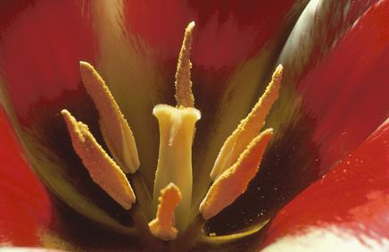
Perfect Flowers
Perfect flowers contain both male and female parts in one flower.
Tomato, Bean, Pea, Broccoli, Cabbage, Carrot, Sunflower, Lettuce
Female
Male
Notes:
Most ornamental flowering plants have perfect flowers.
The next two slides show a few of the many ways that perfect flowers can be structured.

Slide 24
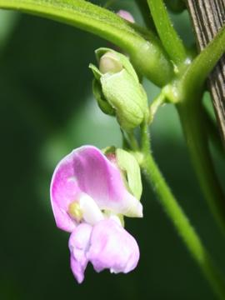
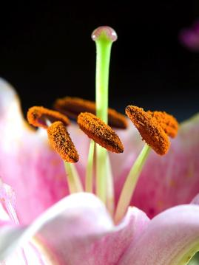
Notes:
The bean flower is a perfect flower with closed petals. The lily a perfect flower with open petals.

Slide 25
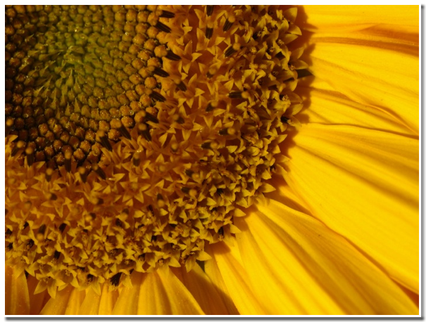
Notes:
Perfect flowers can cluster together in a flower head as in this sunflower.

Slide 26
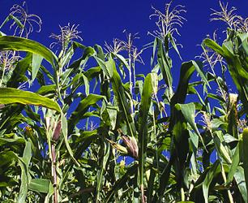
imperfect Flowers
Imperfect flowers are either male or female. The female flowers contain the ovary and pistil and can make fruit. The male flowers contains the stamen that makes pollen and cannot make fruit.
Corn, Squash, Cucumbers, Watermelons, Walnuts
Female ear
Male tassel
Notes:
Imperfect flowers are less common in flowering plants than perfect flowers, but many vegetable plants have imperfect flowers like this corn.

Slide 27
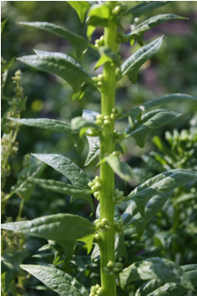
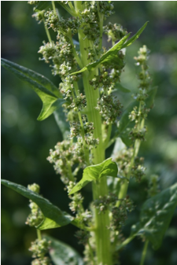
imperfect flowers can be on separate plants: dioecious
Female spinach plants
Male spinach plants
Notes:
Point out the seed producing ovaries on the female and the pollen producing stamen on the male plants.

Slide 28
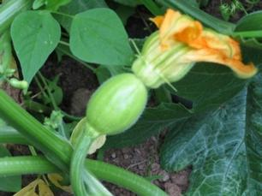
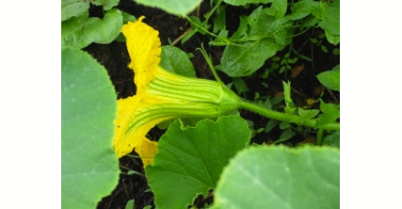
imperfect flowers can be on the same plant: monecious
Female squash flower
Male squash flower
Notes:
Point out the swollen ovary on the female plant.

Slide 29
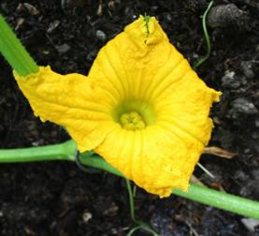
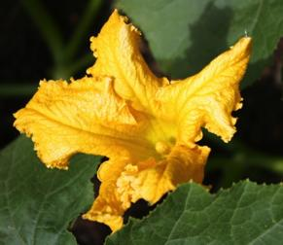
Inside female flower
Hubbard squash viewing
stigma
Inside male flower
Hubbard squash viewing
anther
Notes:
This is an opportunity to address techniques of hand pollination, common in squash.

Slide 30
Inbreeding plants are self fertilizing, or self-pollinating, and essentially mate with themselves. The pollen of one flower on the plant fertilizes the ovule of the same flower. The offspring are therefore very similar to the parent.
Outbreeding plants will cross pollinate and mate with another plant of the same species. The pollen of one plant fertilizes the ovule of another plant of the same species. This mixing produces offspring that can be genetically different from the parent.
Most species will both self and cross pollinate to varying degrees. A plants mating system falls on a spectrum between very inbreeding and very outbreeding.
“very inbreeding” “very outbreeding”
Notes:
EXPLAIN: One end of the spectrum has plant species (like tomatoes) with perfect/bisexual flowers that remain closed…these would therefore be largely self-pollinating and “very inbreeding”. The other end of the spectrum will have dioecious species (like spinach) that rely completely on cross fertilization and are “very outbreeding”.
REFERENCE: Crop Specific Chart, page 25-27, A Seed Saving Guide, OSA for the “Inbreeder/Outbreeder” column
DISCUSS the advantages of inbreeding and outbreeding:
Advantages of inbreeding:
If the plant is very well adapted to its environment, then it insures that the offspring are just as well adapted.
The plant doesn’t have to rely on outside pollinators.
Advantages of outbreeding
Increases genetic variety in the plants gene pool. Because of the mixing of genes there will be slight variety in traits in the offspring.
Some of these new combinations of traits might help the plants ability to adapt to a changing environment.

Slide 31
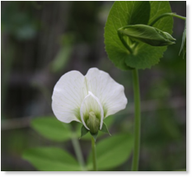
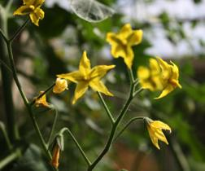
Inbreeders
In order of inbreeding tendency: Peas, lettuce, endive, escarole, tomatoes, common beans.
Self pollination is the norm, but they can cross.
The spectrum of inbreeding can run from
Very Inbreeding VI Primarily Inbreeding PI
VI
PI
Pea flower
Tomato flower
Notes:
In peas the petals of the flower are closed during the period of time that the stigma is receptive to pollen, therefore allowing only pollen from its own anthers to enter. When a pea opens it is already fertilized.
Inbreeders can be the easiest group to save seed from because they naturally self fertilize and don’t require large isolation distances.

Slide 32
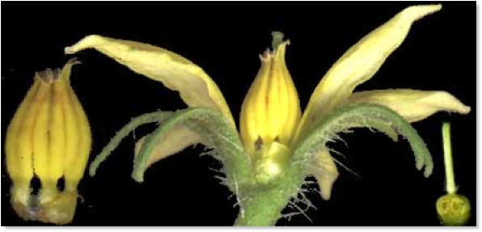
INSIDE A PRIMARILY INBREEDING TOMATO FLOWER
Anther cone
Pistil
Notes:
In tomato flowers the anthers form a cone around the pistil thereby sealing off the flowers stigma from any pollen besides its own.
If this plant is Primarily Inbreeding. What might occur to cause it to not be self fertilizing?

Slide 33
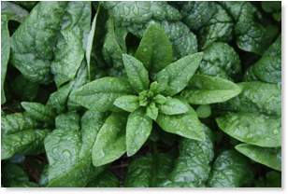
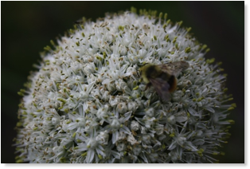
Outbreeders
In order of outbreeding tendency: Corn, beets, spinach, Brassicas, carrots, celery, cucumbers, onions, melons, squash.
The dioecious plants have to outbreed…something has to carry pollen from one plant to another.
The spectrum of outbreeding can run from
Very Outbreeding VO Primarily Outbreeding PO
VO
PO
Spinach flower
Onion flower
Notes:
DISCUSS the following biological mechanisms that assist crossing for outbreeders:
Flowers are not mobile and are forced into attracting pollinators or structuring their flowers so they are receptive to wind movement.
Separation of male & female sexual parts into different flowers forces crossing (monecious and dioecious)
Self-incompatibility: plants that will not receive their own pollen and will only cross, example: Brassica family.
Temporal separation of sexual parts, e.g. pollen release before ripe stigma. For example: Corn is monecious with male and female flowers on the same plant, but the male tassel matures and releases pollen before the female flowers open.

Slide 34
Mating Systems on a spectrum
INBREEDERS
OUTBREEDERS
RECOMMENDED ISOLATION DISTANCES
3 m 6m 150m 500m 1.5-3 km
5-10ft 20ft 500ft 1600ft 3200ft 1-2 miles
Peas Lettuce Tomato Pepper Squash Brassicas Umbels Amaranths Corn
5 plant population acceptable
12 plant population minimum
60 plants population minimum
200 + plant population recommended
RECOMMENDED POPULATION SIZE
Notes:
DISCUSS this slide in detail:
Inbreeding, self-pollinating species require less isolation and population size. Outbreeding, cross-pollinated species require greater isolation distances and population size
point out the population sizes that are acceptable. Notice that outbreeding plants require larger numbers. The larger population numbers for the outbreeding plants will help reduce INBREEDING DEPRESSION – The loss of variation and vigor due to the crossing of genetically similar plants.
Generally - Inbreeders: < 20 plants is OK if the variety is stable and uniform.
Generally - Outbreeders: 80-100 plants minimum.
REFERENCE Crop Specific Chart, page 25-27, A Seed Saving Guide, OSA “Minimum Population Size for Genetic Maintenance” column.

Slide 35
C. Maintaining and Improving Seed Physical and Genetic Quality: POPULATION
Having an adequate gene pool for your crop is essential in retaining the genetic diversity necessary to maintain or improve all the traits you are seeking in your crop including flavor, vigor, resistance, tolerance of drought or saturated soil.
An adequate population size is also necessary to avoid inbreeding depression, particularly in out-breeding crops.
Notes:
1. REVIEW why population numbers are important
Greater numbers of plants will help insure greater genetic diversity, and adaptive resiliency.
Avoiding inbreeding depression.
Maintain genetic diversity and adaptive resiliency of important traits. Larger populations ( 100 plants instead of 10 plants) will have a larger gene pool and more genetic diversity to draw from for the offspring. This can increase the chances of plants in the population receiving a combination (remixing) of genes that can contend with environmental challenges.
Help you deal with a loss of plants that die or fail to flower due to: weather, pests, accidents, higher selection/roguing.
Advanced participants: Narrowing the genepool in outbreeding crops will result in a higher rate of self-pollination, which can lead to inbreeding depression. Self pollinations result in higher rates of double recessive alleles showing up in the population. Some double recessives are expressed as negative or deleterious qualities. The theory is that in in-breeding species these traits were naturally selected against due to the high rate of self pollinating.
ACTIVITY Play the “We are seeds” game.

Slide 36
C. Maintaining and Improving Seed Physical and Genetic Quality: ISOLATION
You can isolate with distance, physical barriers or time.
If you have a plant that is outbreeding, you must identify any other crops of the same species that can cross with your plant and contaminate your crop with unwanted pollen.
If there are species (domestic or wild) that can cross with your crop, you MUST provide isolation in order to maintain the trueness of type of your variety.
Notes:
DISCUSS examples of each type of isolation
Staggered flowering time - many times there’s more overlap in flowering than you anticipate when you stagger your planting dates. Obviously biennial staggering is okay
Collection of seed from center of “block”
increased isolation necessary when large numbers of pollinators are present and when crop populations are large
2. REFERENCE Crop Specific Chart, page 25-27, A Seed Saving Guide, OSA “Minimum isolation distances for home and commercial production” column.

Slide 37
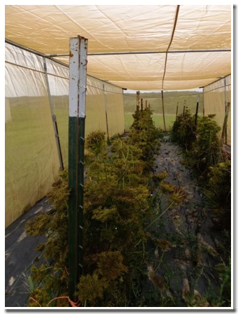
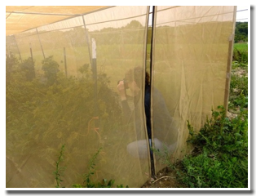
Isolation with physical barriers
Here carrot plants are isolated with tenting.
Other physical barriers might be bags, cages, thick vegetation and or buildings.

Slide 38
Isolation distances
Very Inbreeding (Pea, Lettuce, Endive, Modern Tomato) | 5-20 ft (1.5-6 m)
Primarily Inbreeding (Lima Bean, Heirloom Tomato, Sweet Pepper) | 640 ft (195 m)
Inbreeding with some Insect Pollination (Hot Peppers, Runner Bean, Fava Bean) | 3000 ft (900m)
Insect Pollinated (Carrot, Cabbage, Squash, Eggplant) | 1 mile (1.6 km)
Wind Pollinated (Beet, Corn, Spinach) | 2 miles (3 km)
Notes:
This is a generalized chart using the type of mating system to determine distances between plant. Minimum distances are dependent on “intended use”, no distance is absolute.
Other factors that might alter the distances are:
Open landscape and or high winds
Extremely different varieties that are in the same species: zucchinis and pumpkins Curcurbita pepo
If you are in proximity to a GMO variety of the same species
There are extremely high levels of pollinator activity in your area.

Slide 39
C. Techniques to support reproductive success and maintain your crop’s genetics: ROGUING
Roguing is removing the inferior or underperforming plants in your seed crop. Roguing can be done to eliminate: early bolting, slow to germinate, lack of vigor, size, color, disease or any other undesirable trait.
Walking through your crop and pulling plants that you don’t want to reproduce will eliminate or minimize their contribution of genes to the next generation of seed accidental crossing.
Rogue more than once during the season.
Rogue before flowering to remove unwanted pollen.
Notes:
Point out that selecting and rouging are two sides of the same coin.
Also be sure to consider numbers lost to roguing when you plan population sizes of your crop.
DISCUSS how important it is to determine from the onset what factors you are selecting for in your crop. This becomes the foundation for your process of selection and therefore the process of roguing.
BRAINSTORM with participants some of the qualities of a crop that could be used as part of the selection process for your specific region.
SHARE your practice selection and the of marking plants that you intend to save.
Removing plants after they flower will still minimize genes contributed to the next generation by removing the female portion of the plants genetic contribution. If the species is outbreeding, it may have already contributed some male genes from pollen.
Take care not to over rogue and reduce your population size too much. You may also want to keep some variation in the population to keep a diversity of traits in the future population allowing further opportunities for selection.
Journal question:
Select any vegetable crop that you might consider growing to seed.
You have planted 100 seeds and are observing them as they grow.
Describe the traits that you would like to see in that plant.
If you are going to “save the best and eat the rest”, describe the ones you will eat and the ones you will save for seed.

Slide 40
C. Maintaining and Improving Seed Physical and Genetic Quality: FEED THE SEED
The needs of a seed crop can differ from those of vegetable crops. You will need to:
Balance the available nitrogen.
Provide an adequate source of phosphorous.
Provide spacing needs for crops that become larger as they mature into the seed production.
Some crops might require staking or trellising to keep them from falling over as they mature and dry.
Monitor your seed at all stages for disease and weeds.
Notes:
Spacing requirements need to be stressed. Encourage people to let a few plants flower one year to see how big they get so they can plan for saving seed the next year.
Nitrogen- too little can stunt, too much can encourage vegetative growth rather than flowers and seeds.
Phosphorous is needed for the production of flowers and seed.
Staking…the above mentioned and onions and beets
Spacing – plants we don’t normally see in the seed stage might need more space

Slide 41
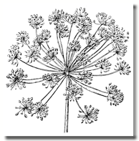
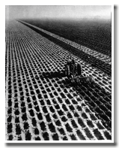
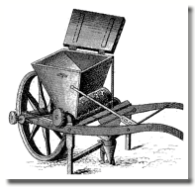
5. Skills and techniques for seed saving
Harvesting and seed cleaning
Storing seed
Notes:
Module #5
Include demonstrations and guided practice with each of the techniques listed.
PLEASE NOTE: ALL PHOTOS AND IMAGES IN THIS POWER POINT ARE OWNED BY ORGANIC SEED ALLIANCE AND ONLY TO BE USED FOR TEACHING THIS SEED SAVING CLASS WITH THIS POWER POINT PRESENTATION. TO CONTACT OSA FOR MORE INFORAMATION PLEASE VISIT:
WWW.SEEDALLIANCE.ORG

Slide 42
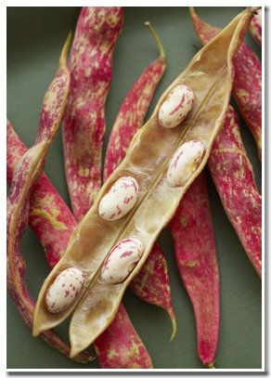
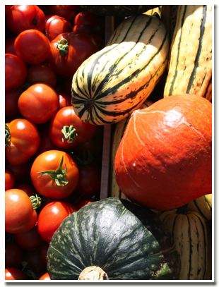
5a. HARVESTING and CLEANING TECHNIQUES
Dry seeded crop
Wet seeded crop
Notes:
How you harvest and dry the seed depends upon whether the crop is dry seeded or wet seeded.

Slide 43
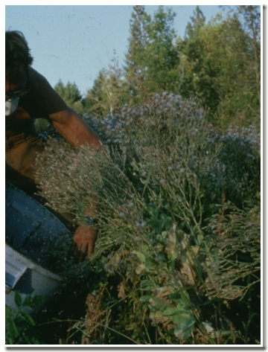
Harvesting techniques:
DRY SEEDED
Pick by hand
Shake into bags or buckets
Pull up the plant and hang
Cut the plant and hang
Lay the plants in windrows
Lay a tarp below the plant and shake or hit the plant to release seed.
Notes:
Reference and discuss dry seeded crop maturity page 11, column 2 OSA guide “Do I have mature seed”. Discuss.

Slide 44
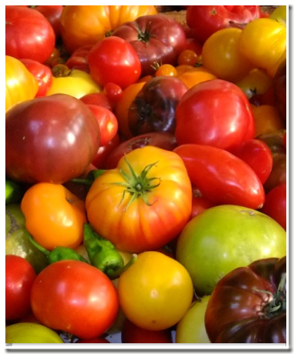
Harvesting techniques:
WET SEEDED
In general let your wet seeded crop mature on the vine as long as possible before harvesting.
The seeds will continue to increase in size and quality for days to weeks after the first fruit is edible.
Notes:
For many types of winter squash the seed quality and germination percentage of the seed will increase if the seed is left in the fruit for two to three months.

Slide 45
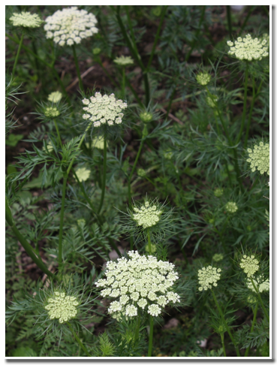
Harvesting techniques:
BIENNIAL ROOT CROPS
Require two years with vernalization
First year is vegetative, no flower/seed formed
Selected plants must overwinter in ground or in cold storage.
Growth in second year produces flowers/seed
Harvest using dry seed techniques.
Notes:
Biennial crops bear seed in the second season following a cold period (vernalization…approx. 8 – 10 wks @ < 50°F /10°C). Therefore, these crops must overwinter before producing flowers and seed the following year.
Introduce the term Steckling: The trimmed root of a biennial crop like carrots, beets, or parsnips that are prepared for replanting using the root-to-seed method.

Slide 46
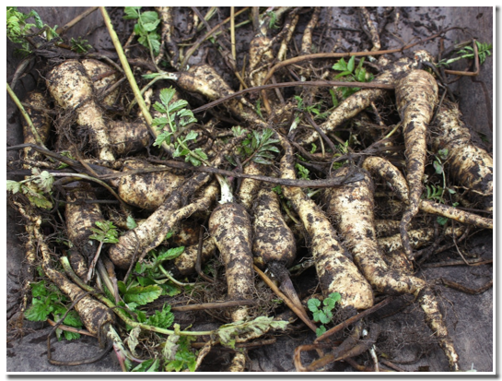
PARSNIPS AS AN EXAMPLE OF A BIENNIAL ROOT CROP
Parsnips allowed to winter over in the ground are dug up
Notes:
If you live in an area with cold or mild winters, often plants can be left in the ground with tops trimmed back and covered with a proper mulch.
If you live in a colder climate, these crops are usually dug up, stored in a cool location and replanted in the spring. When you dig these first-year roots (stecklings) select your roots for the desired traits, remove the excessive tops but leave the crowns, and store them for overwintering in a root cellar. Moist sand is a good medium for stecklings of root crops like carrots, beets and parsnips.

Slide 47
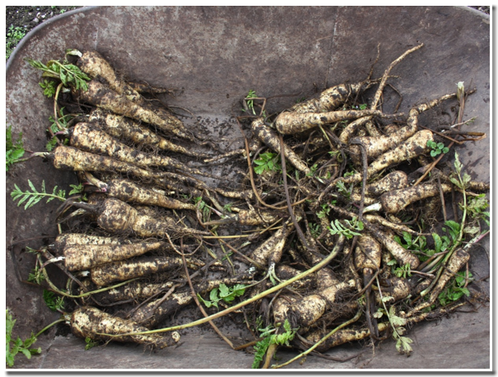
Roots selected for quality: selected roots on the left, discarded roots on the right.
Notes:
Root Selection: “Replant the best, eat the rest”
Brainstorm desired traits with participants – root shape, stem attachment at crown , root smoothness, absence of pest and disease, uniformity, etc.

Slide 48
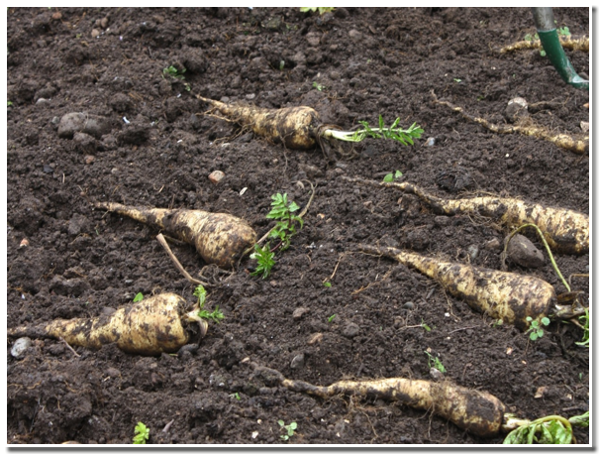
Replant in a block that allows adequate room for maturing and close proximity to encourage pollination
Notes:
Roots may be stored overwinter in a cold room, such as a root cellar if you live in an area with prohibitively cold winters. Remember, the crown of the root must live through the winter and resume growth in the spring. In general, parsnips are more cold hardy than carrots and beets, but if you have hard freezes, you may need to bring roots in to cold storage in the fall.
When roots are replanted trim any dead portions of foliage prior to planting.

Slide 49
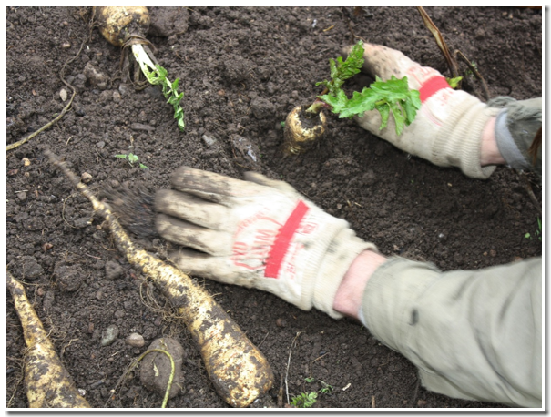
Planted so crown is above soil

Slide 50

Parsnip Flowers
Parsnip going to seed in second year
Notes:
Harvested and dried like other dry seeded crops

Slide 51

TIMING OF THE HARVEST
Select a plant that can complete a full life cycle within your growing season.
Plant early enough to allow full maturity.
Allow the plant to mature before harvest.
Harvest at the optimum seed set.
Either harvest full plant and lay in windrows or select mature seed heads and repeat collections as seed continues to mature.
Notes:
The goal is to time the harvest of seed for maximum viability. Sometimes the perfect “ripeness” for eating (as in these peas) is not the perfect “ripeness” for seed saving. It is a balancing act. Harvesting too early can result in the embryo inside the seed not having the time needed to mature. Harvesting too late can result in loosing seed to predators, shattering or fungus and rot.
Signs of seed maturity:
Brown, dry stems below the attachment of the seed head is a good sign of full maturity and readiness for harvest.
Seed will begin to shatter when fully mature, watching for early signs of shattering is a good indicator that some seed is ready for harvest.
Examine the seed closely. Does it have a full embryo? Is it dry? Does it look like seed you would find in a seed packet?
Most dry seeded crops ripen sequentially from oldest to newest flowers. The optimum time for harvest is generally when some of the first seed to ripen is beginning to shatter, or fully matured. The newer flowers will likely still have some un-mature seed, but if you are harvesting the entire plant then you will need to gauge the optimum timing, which varies from crop to crop. For example, lettuce seed is generally optimum when approximately 70% of the plant is covered in the white papus (fluff).

Slide 52

TIMING OF THE HARVEST
Timing of the harvest varies for each crop.
For example, the seed quality and percent germination of many types of winter squash will increase if the seed is left in the fruit for two to three months.
Notes:
DISCUSS the importance of collecting information about your seed. Keeping good records is the foundation of good seed saving. Refer to crop specific recommendations in the OSA seed saving guide.
BRAINSTORM a list with participants of the important information to record about your seed at harvest. The list might include, common and Latin name, dates of planting, year seed was produced, population size, isolation distances, dates of plant maturity (vegetative, flowering, seed set) list of selection criteria and what off types were rogued, date of seed harvest,

Slide 53

HARVEST/DRY
DRY SEEDED
Allow plant to flower and set seed.
Allow seed heads or pods to dry on the plant.
Pull or cut plants .
Dry plants.
Harvesting radish seed crop into windrows

Slide 54

Endive seed crop laid in a windrow to dry on geotextile cloth
Notes:
Dry seeded plants can be effectively dried in windrows.
Place in rows on fabric or tarp. Do not stack. Geotextile fabric or remay is preferred to a tarp because it can drain moisture and breath. Available from landscaping supply stores.
If porous groundcover then crop can tolerate some precipitation
Be sure to turn the crop
Allow to fully dry, this will help separate the seed from the plant material.

Slide 55

Drying beet seed in a greenhouse on tables
Notes:
Another effective method is dying on tables in hoop house. This drying technique is used for members of the carrot, lettuce, brassica, grains, onion, families.
Completes maturity
Dries plant material for separation
Preserves seed
Techniques: breathable cloth, table, screens, turning, fans, heat

Slide 56

HARVEST/DRYING
WET SEEDED CROPS
Gauge the ripeness of the fruit you are harvesting by color, texture, and size.
Harvest at the optimum ripeness for maximum viability of your crop.
Notes:
Optimum ripeness for maximum viability is often different than optimum ripeness for eating.
Signs of maturity vary by crop, but here are a few guidelines:
Tomatoes – slightly more ripe than eating stage, when the skin begins to pull slightly
Zucchini and Cucumbers – full size, turning yellow on bottom, or fully yellow in cucumbers
Winter squash – edible maturity

Slide 57


Harvest the fruit when it is ripe. Clean seed from pulp.
Notes:
For example, tomato seeds germinate better if the fruit is partially rotted before seed drying.
Tomatoes and peppers benefit greatly from fermentation
Cucurbits do not require fermentation, but seed will come clean more easily with a fermentation

Slide 58


Allow to set 2-3 days in warm location until fermentation begins.
Notes:
Do not add water to the fruit slurry. It decreases the concentration of sugars and slows the process, which can lead to premature germination and/or disease problems.
Fermentation also makes seed cleaning easier by loosening the pulpy residue clinging to the seed. In addition, it removes a germination inhibiting gel from the seed.

Slide 59

Rinse, decant and collect seed. Place on screens and allow to dry
Notes:
Dry immediately!
Spread thin on screen if possible
Provide good air circulation
Stir seeds on screen often
The two crops that experts agree should be fermented are tomatoes and cucumber.
Squash can be rinsed and dried without fermentation.
Other wet seeded crops can be fermented briefly (1-2 days) to soften the pulp and make cleaning easier.

Slide 60


CLEANING TECHINQUES Threshing, Winnowing, Screening

Slide 61

THRESHING
Threshing is the process used to break up the plant material and release the seed. It is a typical step before cleaning.
Threshing can be done with a machine but also by
Rubbing seed heads between your hands.
Rolling up a tarp and stepping on it.
Stomping seeds in a bucket or bag.

Slide 62


All crop thresher
Belt thresher
Notes:
If appropriate discuss mechanical threshing.

Slide 63

WINNOWING
Winnowing is the process of using an air current to separate seed from non-seed material based on weight.
The heavier materials fall closer to the wind source while lighter materials are carried further from the wind source.
Notes:
This skill requires practice and should not be done the first time “without a net” i.e. without a tarp below to catch seed.
The magnitude of the breathe, size of the seed and the shape of the bowl all effect the success of the process.
Practice, practice, practice.
For large quantities of seed, fans or the wind can be used.
Have a variety of seed available to clean using varied methods.

Slide 64

Box fans are excellent for gravity separation. Notice two containers
Notes:
Demonstrate this technique

Slide 65

Light seed and chaff Heavy seed
Notes:
Which is closer to the fan?

Slide 66


SCREENING
Separation by size after threshing or winnowing.
Remove larger chaff – “top screening”. Remove smaller debris – “bottom screening”.

Slide 67

5b. STORING SEED
Notes:
SEEDS ARE ALIVE!
Inside of every seed is an embryo living on its stored food (endosperm).
To prolong the life of a seed you must slow down the rate at which the embryo uses its food.
You can do this by keeping the seed cool and dry.
Use this diagram to explain the purpose of the structures inside the seed.
Play peel the bean.

Slide 68

To maximize the life of your seed keep it
Cool.
Dry.
Protected from insects and rodents.
THE most important thing to remember is that the seed should be very dry before it is placed in storage.
Notes:
Conditions for optimum storage:
Cool, dry, stable temperature, no water, no critters.
Cleanliness
Temperature F + % Humidity = < 100
Containers: airtight vs. breathable
Envelope test – when a coin envelope is put into the seed lot, will it seal within 1 to 2 days?
Discuss and demonstrate Germination Testing. Place 100 seeds on a moist paper towel. Roll up the towel and place inside a zip-lock bag. 3-7 days later open and count the number germinated. This gives you the % germination rate.

Slide 69
Every seed has a different longevity based on how it is stored.
A general rule for typical* storage:
1 year: onion, parsley, parsnip, salsify.
2 year: dandelion, sweet corn, leek, okra, pepper.
3 year: asparagus, beans, carrot, celeriac, celery, chervil, Chinese cabbage, kohlrabi, pea, spinach.
4 years: beets, Brussels sprouts, cabbage, cauliflower, chicory, eggplant, fennel, kale, mustard, pumpkin, rutabaga, squash, Swiss chard, tomato, turnip, watermelon.
5 years: cardoon, collards, endive, lettuce, muskmelon, radish, water cress.
*typical might look like ambient indoor conditions
Notes:
Seed to Seed is an excellent reference the “shelf life” of properly stored seeds.
Notes from a seed saver. “Remember to obtain a “representative sample” sampling seeds from each individual plant as future reproduction stock (mainly important for outbreeders) vs using what is left in the bottom of the jar.”
Demonstrate a germination test.

Slide 70
The longevity of a seed also depends upon the TEMPERATURE and DRYNESS in which it is stored.
For example, a typical life span of a bean is 3 years. But, with optimum coldness and dryness, a bean seed can last up to 10 years, 20 years if it’s frozen.
Dry matters a lot more than cold.
Notes:
Reference A Seed Saving Guide, Seed Storage: Know how to protect your seed harvest and keep it viable for specifics on percent of moisture and achieving a “very dry” seed.

Slide 71



6. Review: Reflecting on the learning
Notes:
Module #6

Slide 72

Reviewing the questions to ask and answer before growing seed.
Why am I saving seed?
What seed is best for me?
What biological principles are fundamental to seed saving?
What skills and techniques are needed to grow and save seed?
Notes:
1. Ask participants to review the 4 questions.
2. Reference resources for deepening their understanding.

